Slide 1
Predicting Wholesale Tea Prices
“Tea buy, or not tea buy, that is the question”
For Sellers, Buyers, and Auctioneers
Arun Mitra, Data Scientist

Slide 2

The Opportunity
What value can we add?
India is the 2nd largest producer of tea in the world
28% of the world’s tea is produced in India
Complex dynamics throughout the value chain are impacted by wholesale tea prices
The Tea Board of India conducts weekly auctions at 7 auction centers around the country
Even reasonably good predictions of the prices helps all parties involved
Sellers
Buyers & exporters
Auctioneers
We need a good prediction model!

Slide 3
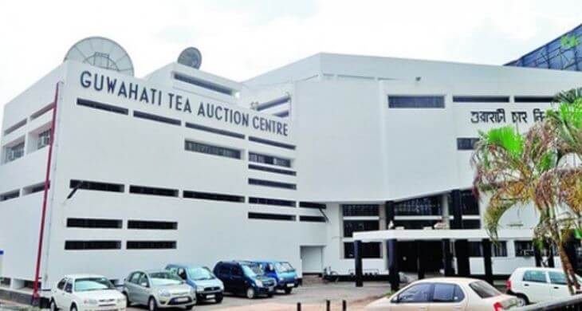
Who needs our predictions?
When do they need it?
Sellers (Tea Estates):
How much to offer?
At which auction?
At what price?
Buyers (Domestic Packeteers & Exporters):
How much to buy for downstream demand?
What price to quote for an overseas bid?
Auctioneers:
Better market intelligence reports
Sellers: At least 3 weeks ahead of each auction, to plan and execute transportation
Buyers: 3 to 6 weeks ahead (to negotiate with their buyers)
Auctioneers: 3 weeks to 2 months ahead

Slide 4

The Data
Data Source:
Tea Board of India (https://www.teaauction.gov.in/pages/News.aspx)
Description of Data:
Weekly data from 2009 until now
Offered Quantities
Sold Quantities
Average Price
10 types of tea
CTC Leaf
CTC Dust
Orthodox Leaf
Orthodox Dust
… and 6 other minor categories
3 auction centers in southern India
Cochin
Coimbatore
Coonoor
4 auction centers in northern India
Kolkata
Guwahati
Jalpaiguri
Siliguri

Slide 5
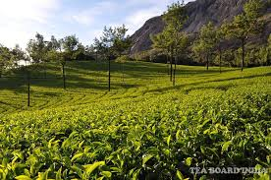
The Data
Future Scope
The initial scope was limited to:
Data starting from 2012
The 4 major tea types only:
CTC Leaf
CTC Dust
Orthodox Leaf
Orthodox Dust
1 auction center
Cochin in Southern India
Missing values (about 2%):
Replaced by 3 prior weeks moving averages
Tea Quality Index Data
Consumer Price Index Data
Labor Supply(Shortage) Data
COVID19 Lockdowns
Monsoon (Rainfall) Data
Cross Currency Exchange Rates
Retail Tea Price Data

Slide 6
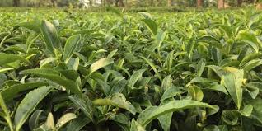
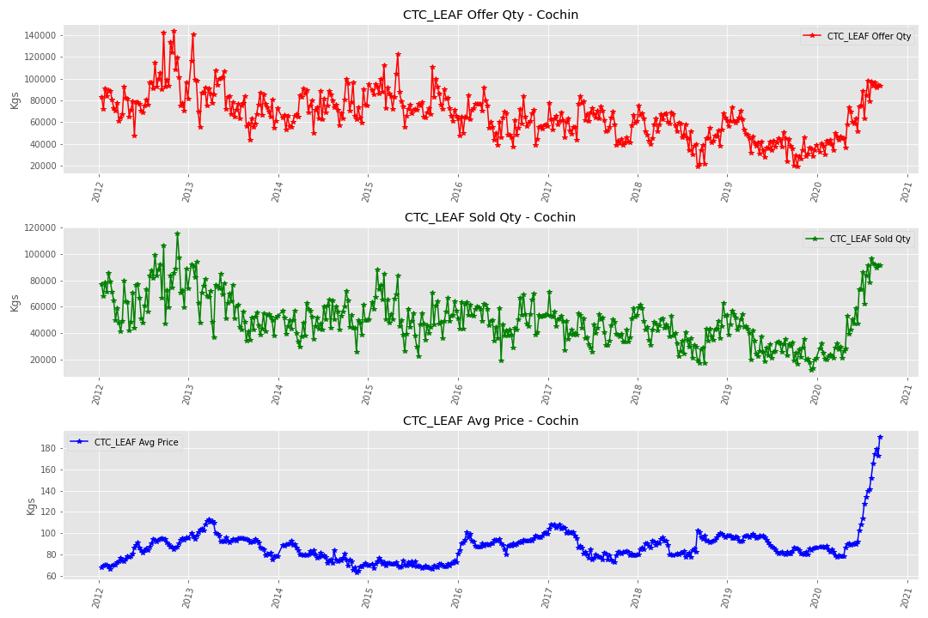
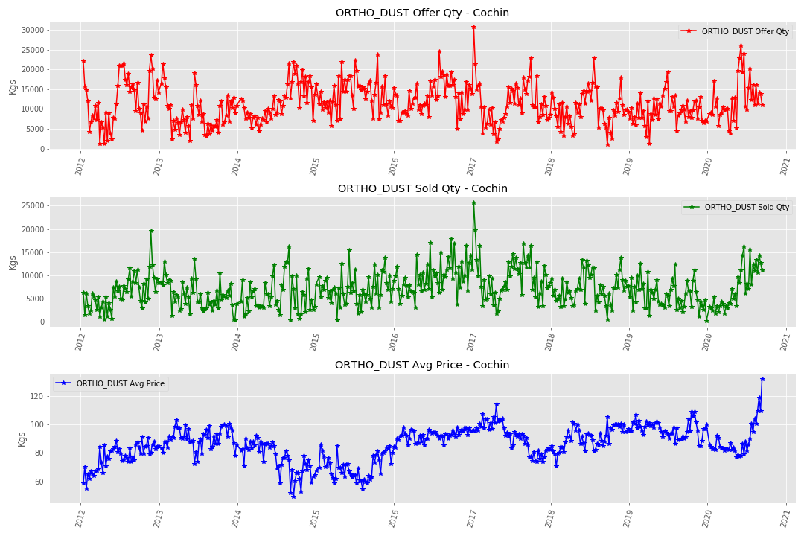
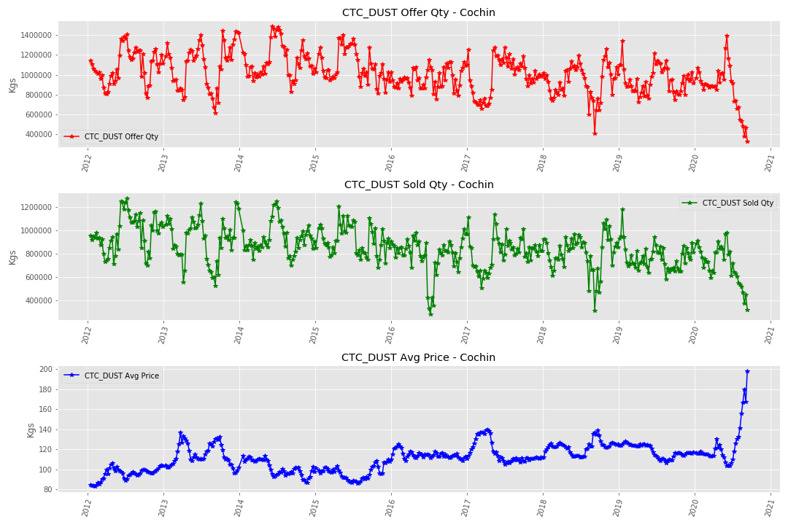
EDA
Steep price escalation Steep supply decline
CTC Leaf
CTC Dust
Orthodox Leaf
Orthodox Dust

Slide 7
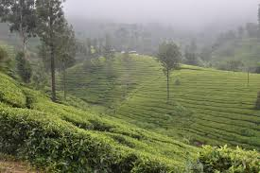
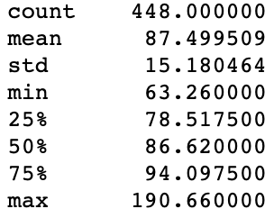
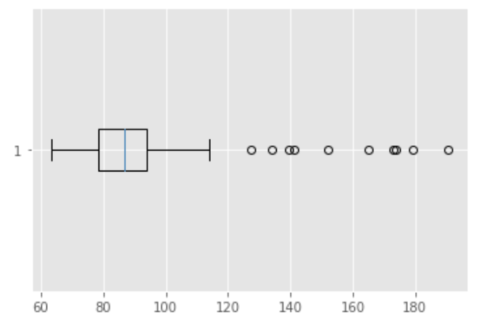
EDA
Decided to begin with CTC Leaf data for Cochin
Outliers are mostly in the last 2 months of 2020.
Recent steep increases in price as supplies have been disrupted due to Source: Wall Street Journal
Labor shortages
Port closures
Other logistical issues
Excluded 2020 data (for now)
Dealing with COVID19 impact will require more exogenous data

Slide 8

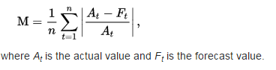
Decide on model metric
How is MAPE calculated?
What is a good MAPE?
MAPE: Mean Absolute Percentage Error
Is widely used for forecast accuracy
Has scale-independency
Is easily interpreted
But is NOT good if actual values are at or near zero
Less than or equal to 10%
Notes:
Although the concept of MAPE sounds very simple and convincing, it has major drawbacks in practical application,^{[3]} and there are many studies on shortcomings and misleading results from MAPE.^{[4][5]}
It cannot be used if there are zero values (which sometimes happens for example in demand data) because there would be a division by zero.
For forecasts which are too low the percentage error cannot exceed 100%, but for forecasts which are too high there is no upper limit to the percentage error.
MAPE puts a heavier penalty on negative errors,
{\displaystyle A_{t}<F_{t}}
than on positive errors.^{[6]} As a consequence, when MAPE is used to compare the accuracy of prediction methods it is biased in that it will systematically select a method whose forecasts are too low. This little-known but serious issue can be overcome by using an accuracy measure based on the logarithm of the accuracy ratio (the ratio of the predicted to actual value), given by
{\displaystyle \log \left({\frac {\text{predicted}}{\text{actual}}}\right)}
. This approach leads to superior statistical properties and leads to predictions which can be interpreted in terms of the geometric mean.^{[3]}
To overcome these issues with MAPE, there are some other measures proposed in literature:
Mean Absolute Scaled Error (MASE)
Symmetric Mean Absolute Percentage Error (sMAPE)
Mean Directional Accuracy (MDA)
Mean Arctangent Absolute Percentage Error (MAAPE): MAAPE is a new metric of absolute percentage error, and has been developed through looking at MAPE from a different angle. In essence, MAAPE is a slope as an angle, while MAPE is a slope as a ratio.^{[5]}

Slide 9

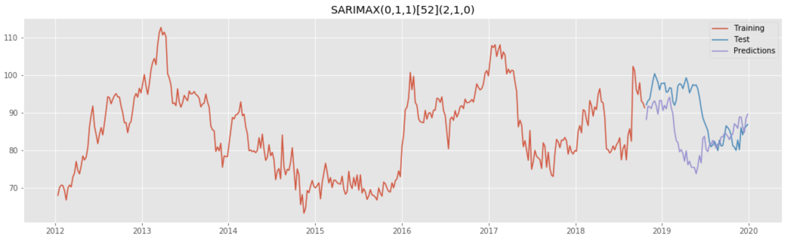
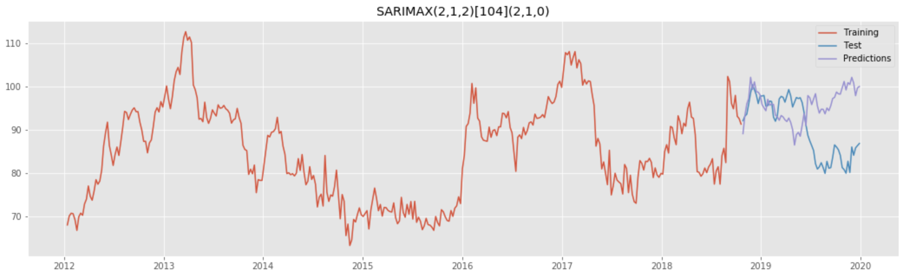
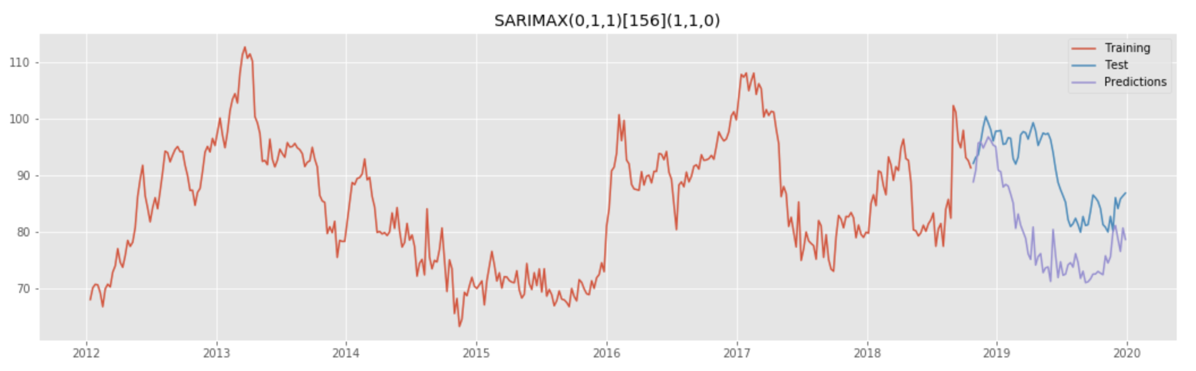
AUTO ARIMA : Test
SARIMAX (0,1,1)(2,1,0)[52] : seasonality of 52 weeks: AIC = 1940.700 | MAPE = 9.4475
SARIMAX(2,1,2)(2,1,0)[104] : seasonality of 104 weeks: AIC = 1662.785 | MAPE = 8.5770
SARIMAX(0,1,1)(1,1,0)[156] : seasonality of 156 weeks: AIC = 1426.932 MAPE = 13.7874
Best Seasonal ARIMA Model:
p = 2, d = 1, q = 2
Seasonality = 104 weeks
P = 2, D = 1, Q = 0
MAPE on test data = 8.58%
AIC = 1662.785
Notes:
A non-seasonal ARIMA model is classified as an "ARIMA(p,d,q)" model, where: p is the number of autoregressive (AR) terms (how many lagged series are going to be used to forecast periods ahead), d is the number of non-seasonal differences needed for stationarity, and, q is the number of lagged forecast errors in the prediction equation.

Slide 10
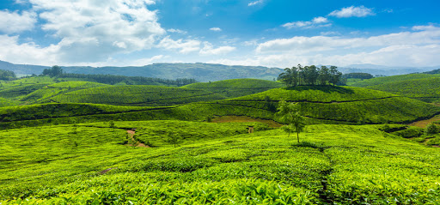
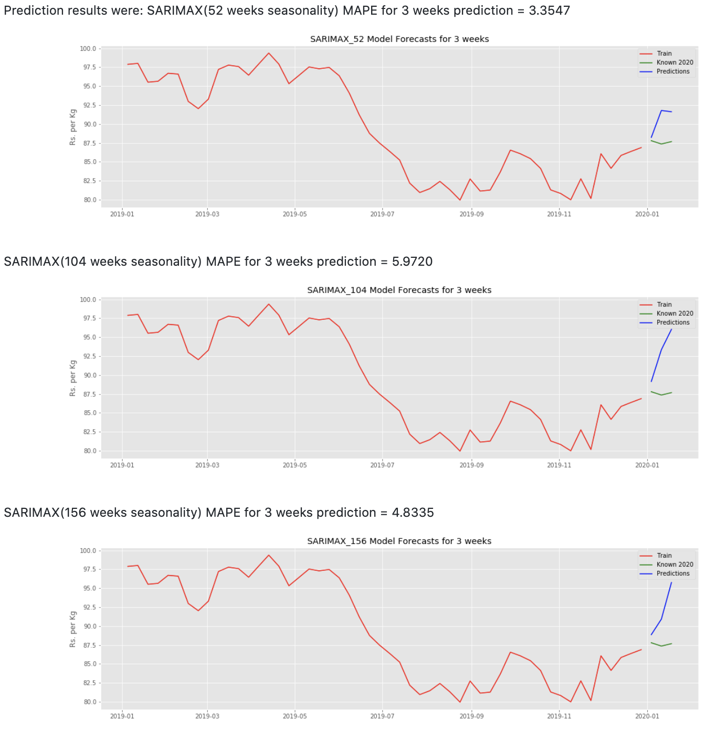
AUTO ARIMA : Predict
Out-of-sample Seasonal ARIMA Model predictions for 3 weeks into the future (early 2020)
Some examples are:
SARIMAX 52 weeks: MAPE = 3.37%
SARIMAX 104 weeks: MAPE = 5.97%
SARIMAX 156 weeks: MAPE = 4.83%

Slide 11

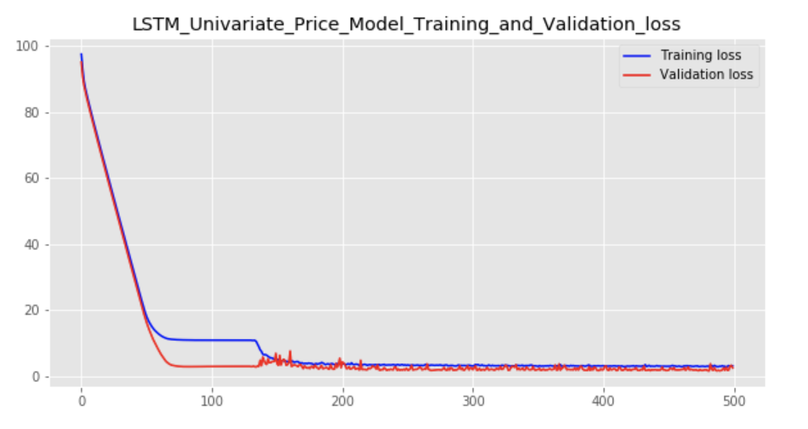
Univariate LSTM: Build & Fit
Single Step Model: "sequential_7" (Price only)
_________________________________________________________________
Layer (type) Output Shape Param #
=================================================================
lstm_8 (LSTM) (None, 10, 32) 4352
_________________________________________________________________
dropout_4 (Dropout) (None, 10, 32) 0
_________________________________________________________________
lstm_9 (LSTM) (None, 32) 8320
_________________________________________________________________
dense_4 (Dense) (None, 1) 33
=================================================================
Total params: 12,705
Trainable params: 12,705
Non-trainable params: 0
activation='relu'
optimizer='adam'
loss='mape'
500 Epochs
MAPE 3.19%

Slide 12

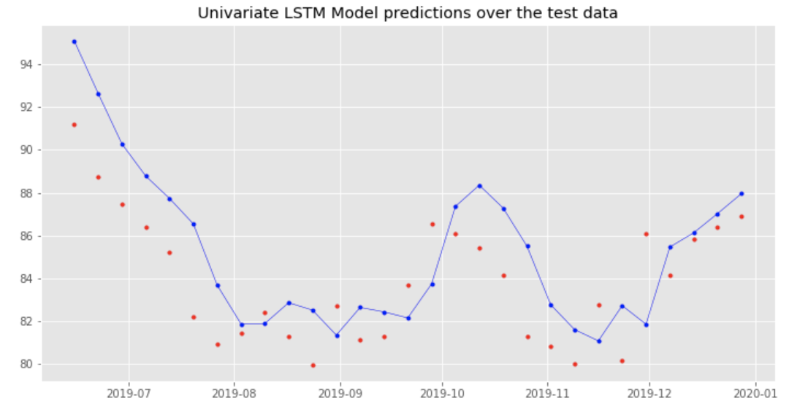
Univariate LSTM: Predict
MAPE on test data = 10.99%

Slide 13
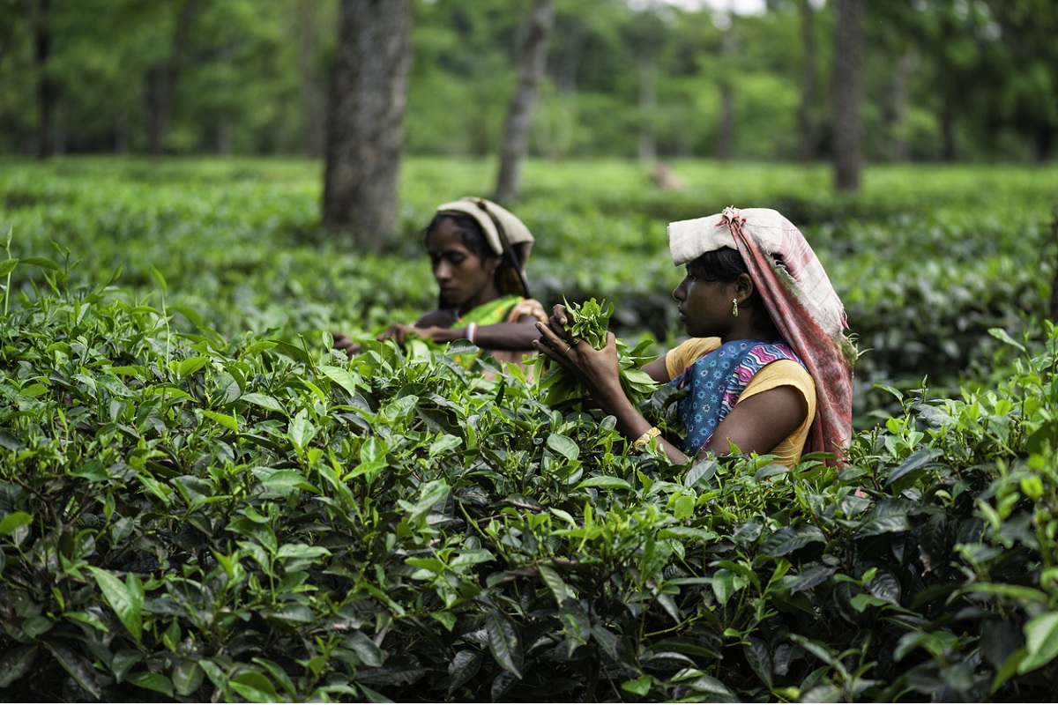
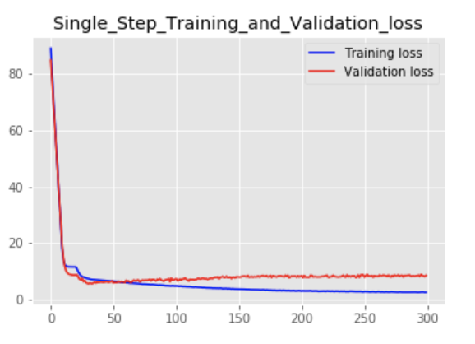
Multivariate LSTM: Build & Fit
Single Step Model: "sequential_10" (Price, Offer Quantity, Sold Quantity)
_________________________________________________________________
Layer (type) Output Shape Param #
=================================================================
lstm_14 (LSTM) (None, 10, 32) 4352
_________________________________________________________________
dropout_7 (Dropout) (None, 10, 32) 0
_________________________________________________________________
lstm_15 (LSTM) (None, 32) 8320
_________________________________________________________________
dense_7 (Dense) (None, 1) 33
=================================================================
Total params: 12,705
Trainable params: 12,705
Non-trainable params: 0
activation='relu'
optimizer='adam'
loss='mape'
300 Epochs
MAPE 2.50%

Slide 14
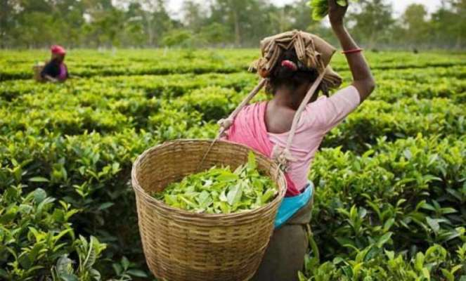
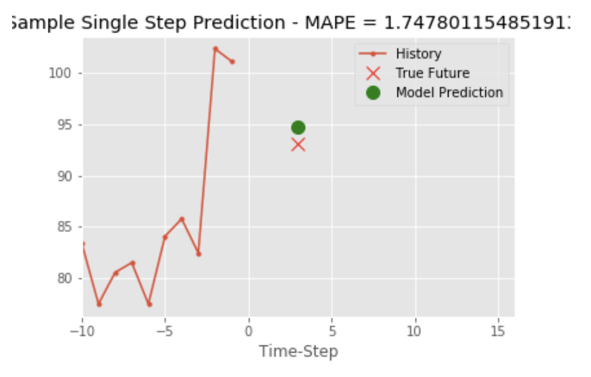
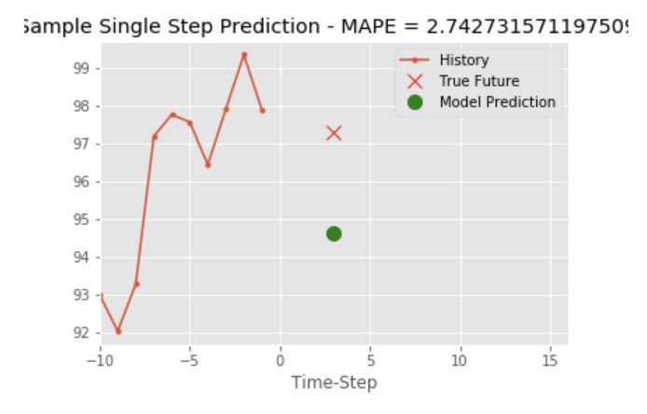
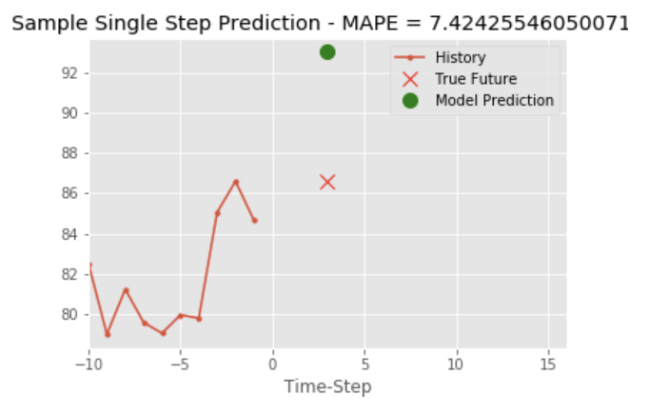
Multivariate LSTM: Predict
Examples of single step 3-weeks ahead predictions

Slide 15


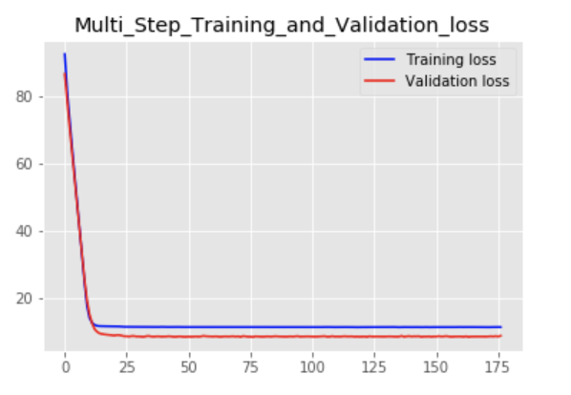
Multivariate LSTM: Build & Fit
Multi Step Model: "sequential_4" (Price, Offer Quantity, Sold Quantity)
_________________________________________________________________
Layer (type) Output Shape Param #
=================================================================
lstm_6 (LSTM) (None, 10, 32) 4608
_________________________________________________________________
dropout_3 (Dropout) (None, 10, 32) 0
_________________________________________________________________
lstm_7 (LSTM) (None, 32) 8320
_________________________________________________________________
dense_3 (Dense) (None, 3) 99
=================================================================
Total params: 13,027
Trainable params: 13,027
Non-trainable params: 0
activation='relu'
optimizer='adam'
loss='mape'
175 Epochs (early stopping)
MAPE 11.32%

Slide 16

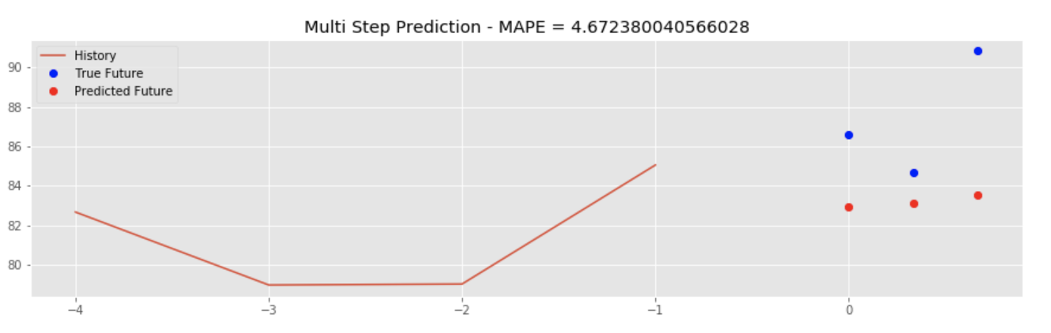
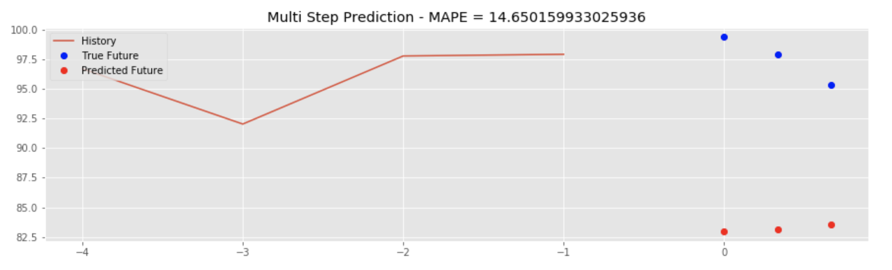
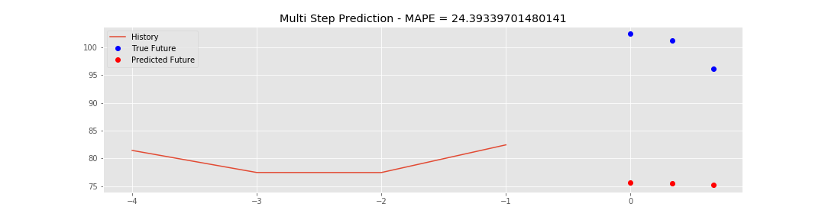
Multivariate LSTM: Predict
Examples of multi-step 3 weeks’ predictions immediately into the future
Examples of in-sample Multivariate Multi-step LSTM Model predictions for 3 weeks into the future:
MAPE = 4.67%
MAPE = 14.65%
MAPE = 24.39%

Slide 17
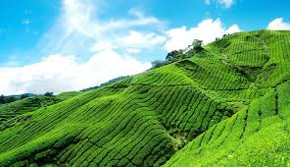
Summary of current findings
Univariate Seasonal ARIMA predictions
Multi Step (every week for 3 weeks)
MAPE = 3.37% SARIMAX Seasonality 52 weeks
MAPE = 5.97% SARIMAX Seasonality 104 weeks
MAPE = 4.83% SARIMAX Seasonality 156 weeks
Univariate LSTM predictions
Single Step (1 week out)
MAPE = 8.58%
Multivariate LSTM predictions
Single Step (3 weeks out)
Best MAPE = 1.75%
Multi Step (every week for 3 weeks)
Best MAPE = 4.67%

Slide 18

Next Steps
Add 2020 data
Improve LSTM
More gridsearch to tune hyperparameters
Longer step predictions
More features
All 4 major tea categories, then the other categories
Add other Auction Centers
Other exogenous features to investigate
Tea Quality Index, Consumer Price Index, Cross-currency exchange rates, Monsoon rain data, Labour supply data (COVID19 Lockdowns)
Automate pipeline, from ...
Tea Board published data, into …
This application, and out to …
Delivery of predictions (Web UI app & API)
Thank you for your attention!
Notes:
Multivariate SARIMAX
Add quantities
Add other categories
Holt-Winters Exponential Smoothing
Deals well with seasonality and trend

Slide 19
Appendix

Slide 20
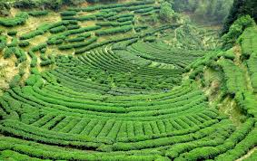
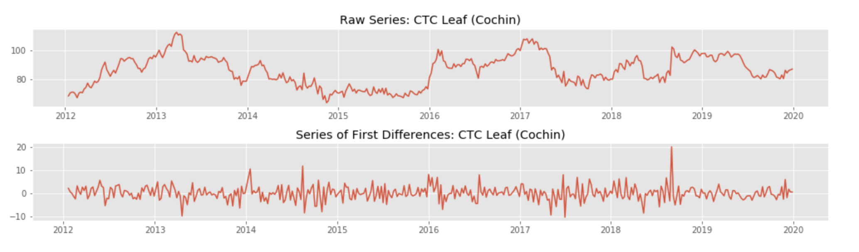
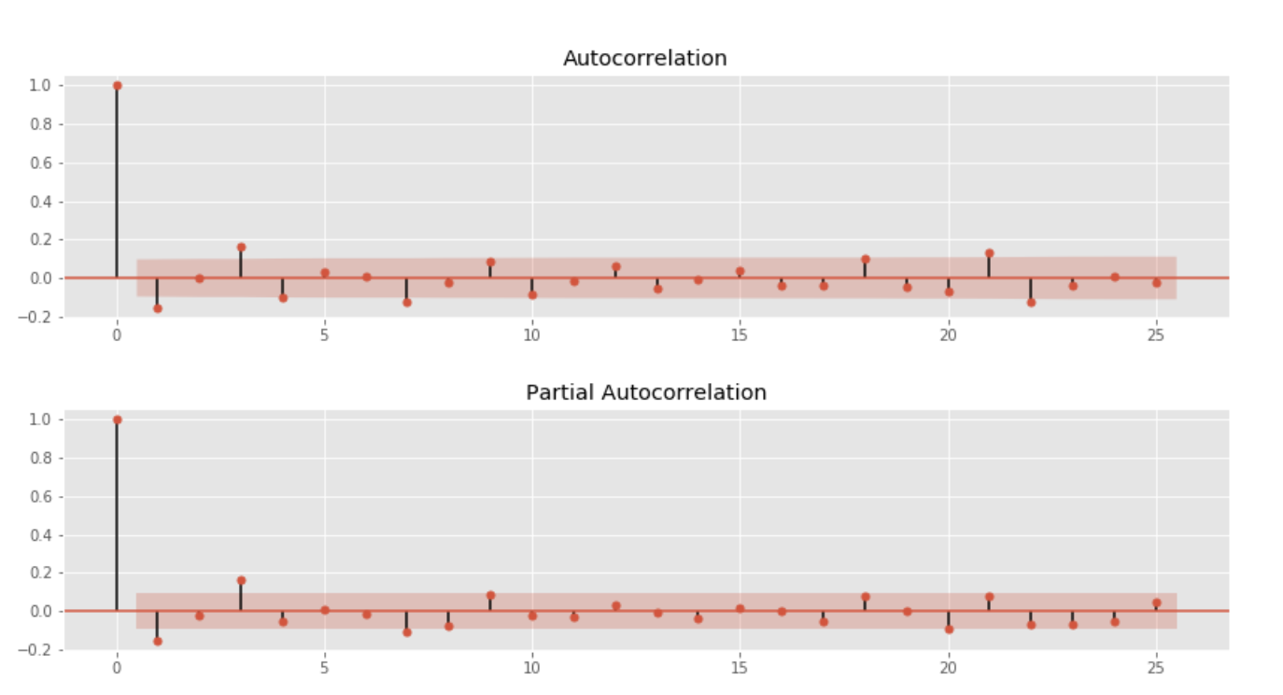
ARIMA
Univariate non-seasonal ARIMA
Data is non-stationary (ADF p-value = 0.23)
After Differencing was done (ADF p-value = 0.00)
Based on autocorrelation and partial autocorrelation plots:
Non-seasonal ARIMA with:
p = 1, d = 1, q = 1 was tried:
AIC = 2090
Other values of p,d,q were tried but AIC remained high:
AIC = 2081
ACF and PACF checked out OK
Notes:
ACF is a bar chart of the coefficients of correlation between a time series and lags of itself.
PACF is a plot of the partial correlation coefficients between the time series and lags of itself
Since autocorrelation is the linear correlation of a signal with itself at two different points in time, ACF (autocorrelation function) is just such correlation as a function of the lag ℎ between two points of time, like 𝑎𝑐𝑓(ℎ)=𝑐𝑜𝑟𝑟(𝑥𝑡, 𝑥𝑥+ℎ)
PACF (partial autocorrelation function) is essentially the autocorrelation of a signal with itself at different points in time, with linear dependency with that signal at shorter lags removed, as a function of lag between points of time. Informally, the partial correlation between 𝑥𝑡 and 𝑥𝑡+ℎ is the autocorrelation between 𝑥𝑡 and 𝑥𝑡+ℎ without the contribution of 𝑥𝑡+1,𝑥𝑡+2,....,𝑥𝑡+ℎ−1.

Slide 21

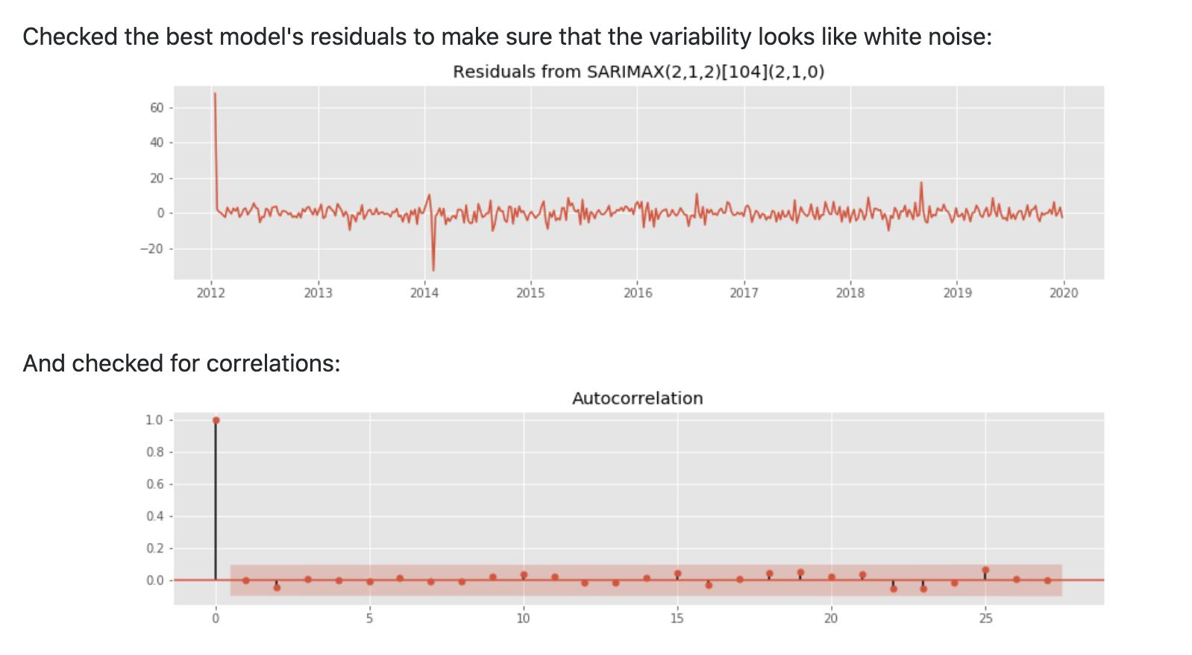
AUTO ARIMA : Test
Best Seasonal ARIMA model
SARIMAX (p=2, d=1, q=2) [104 weeks] (P=2, D=1, Q=0)
We are ready to make some predictions!

